Slide 1

Ailments of Alignment: Hurdles in Adapting Large Language Models to Follow Human Demands
Daniel Khashabi
Notes:
Thank you for having me! It's an honor to be here!
Fun fact: Actually I was very close to coming to UMD for my PhD program, alas I ended up going to UIUC. Only a few months later I realized that I should have checked the weather before signing my offer.
At any rate, I am glad to be back here now in DMV area. It is an honor to be here and speak with you about ..
=====
Fun fact actually: I was admitted to UMD for a PhD but chose UIUC instead because I forgot to check the midwest weather before signing my offer.

Slide 2
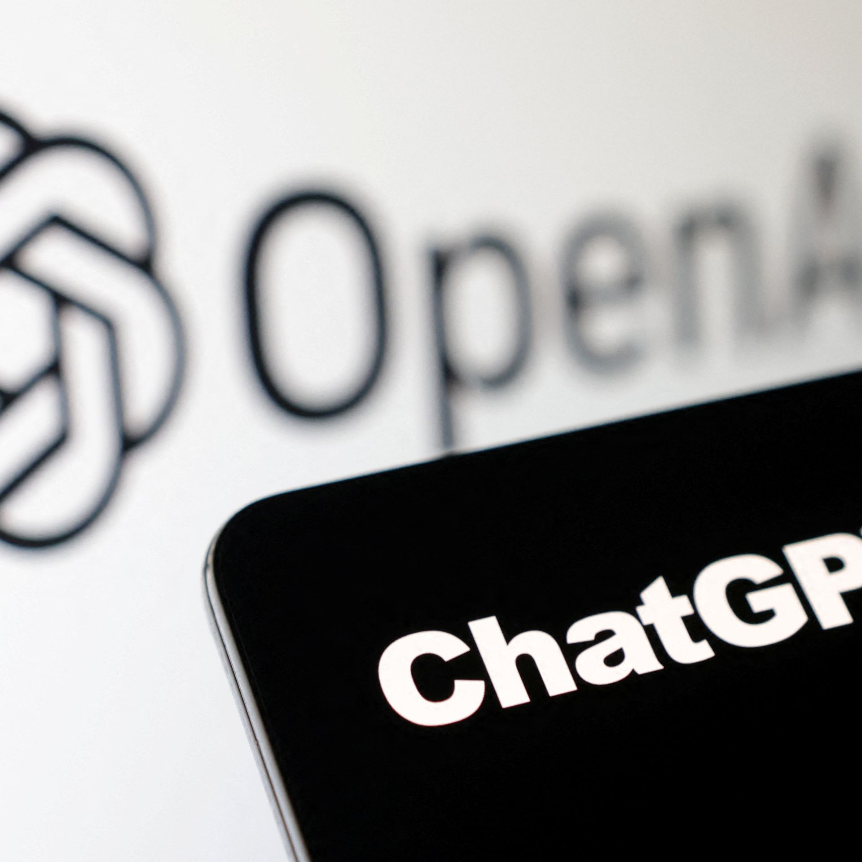
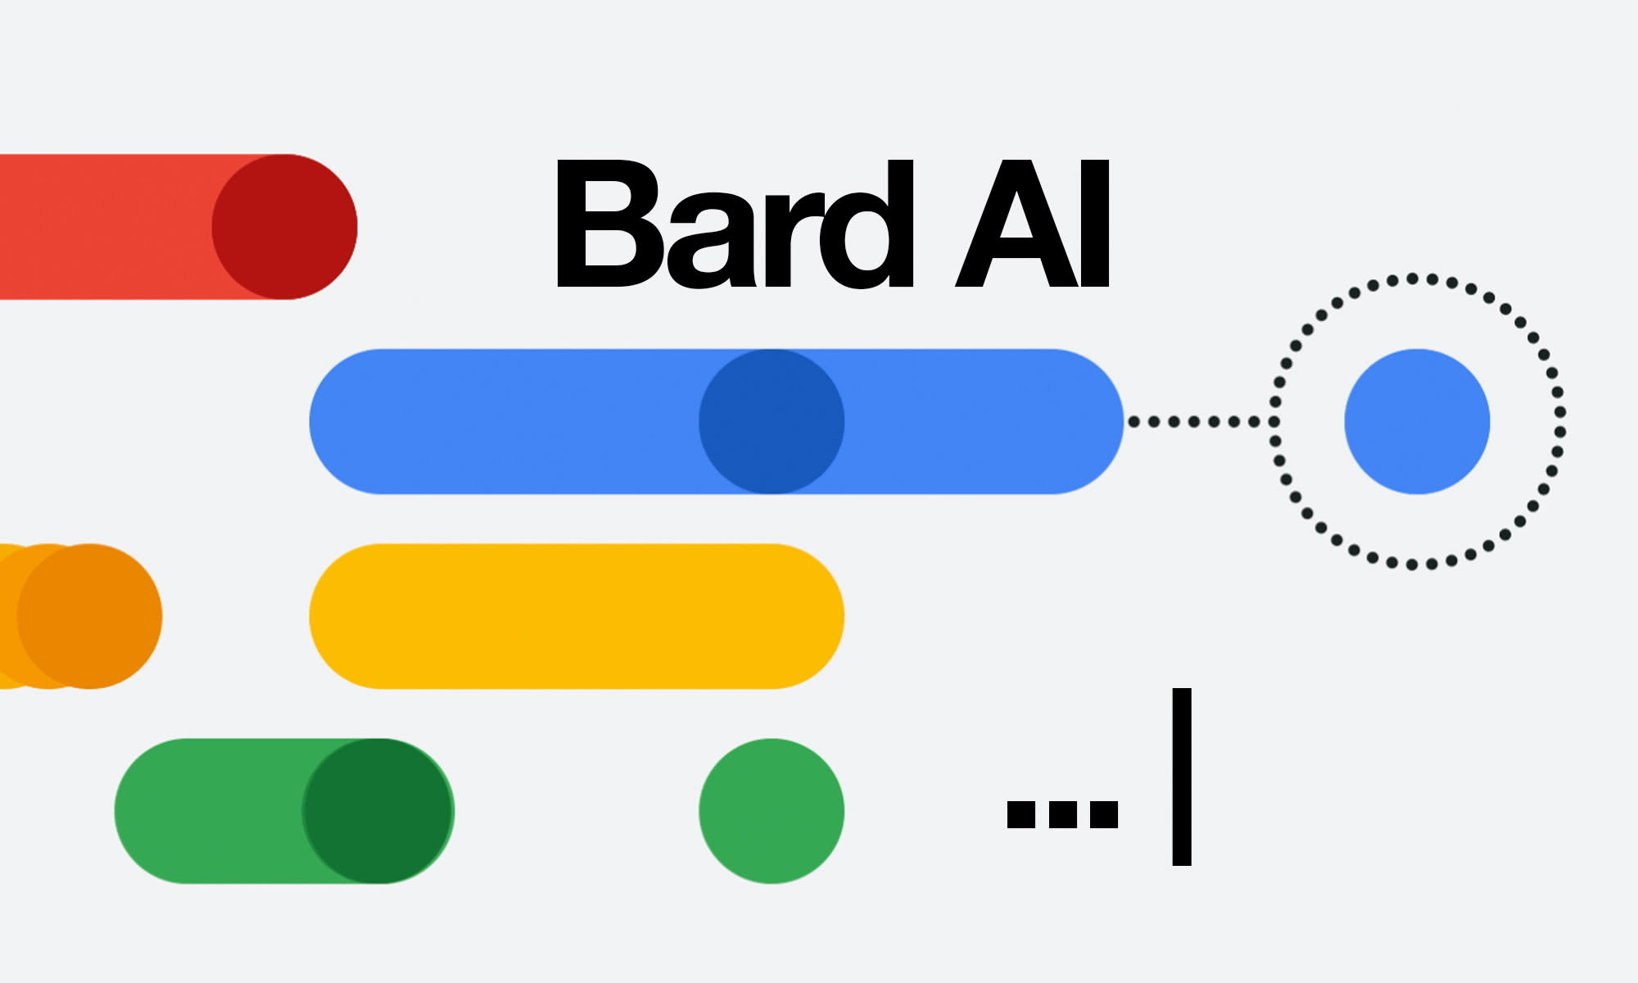


Chatbots are the buzz!!
Notes:
So, it goes without saying: chatbots driven by large language models are all the buzz these days.
And rightly so ….

Slide 3
These Chatbots are Real Generalists!
Notes:
They seem to have fluent dialogue, solve math problems, and ….
Pass standardized exams
Or even help us with building a website.
This is great! ….

Slide 4
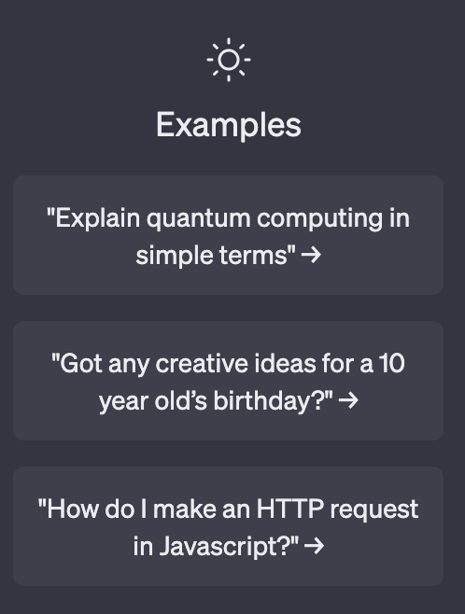
These Chatbots are Real Generalists!
Basic needs
Notes:
They seem to have fluent dialogue, solve math problems, and ….
Pass standardized exams
Or even help us with building a website.
This is great! ….

Slide 5
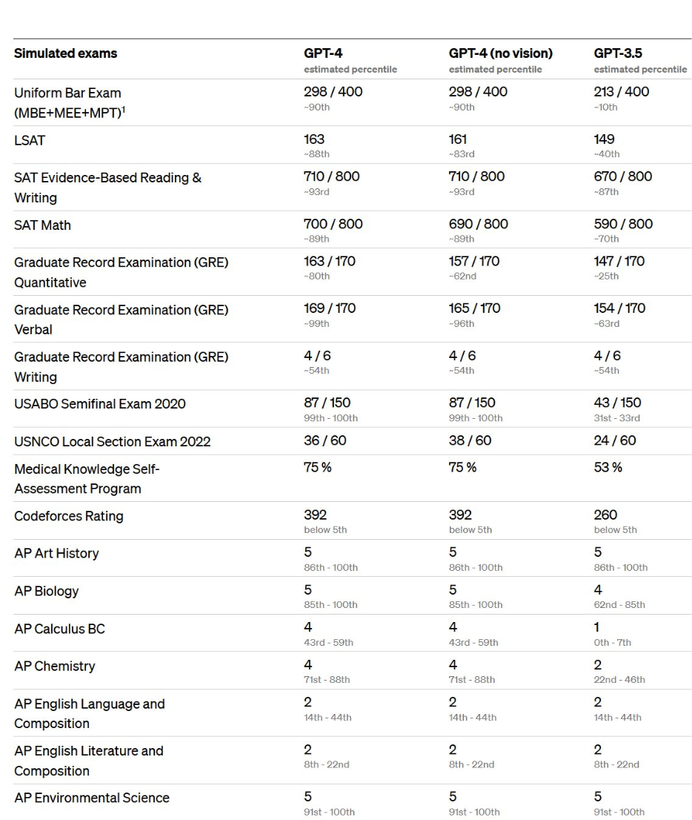
These Chatbots are Real Generalists!
Basic needs
Standardized exams
Notes:
They seem to have fluent dialogue, solve math problems, and ….
Pass standardized exams
Or even help us with building a website.
This is great! ….

Slide 6
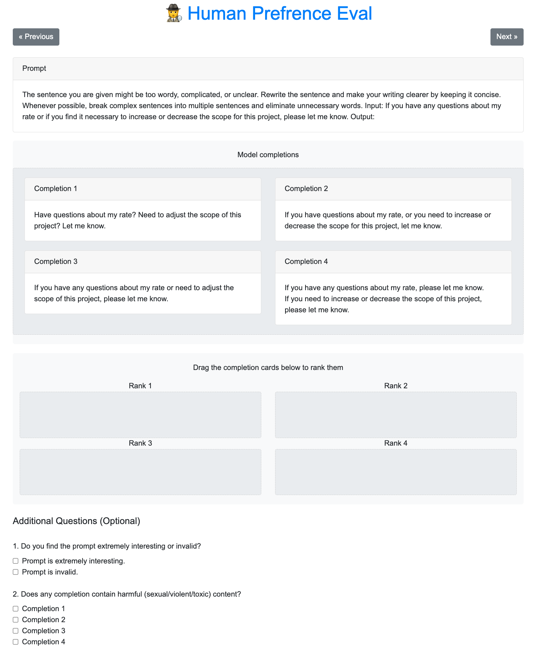
These Chatbots are Real Generalists!
Basic needs
Standardized exams
Writing a real website for me!
Notes:
They seem to have fluent dialogue, solve math problems, and ….
Pass standardized exams
Or even help us with building a website.
This is great! ….

Slide 7
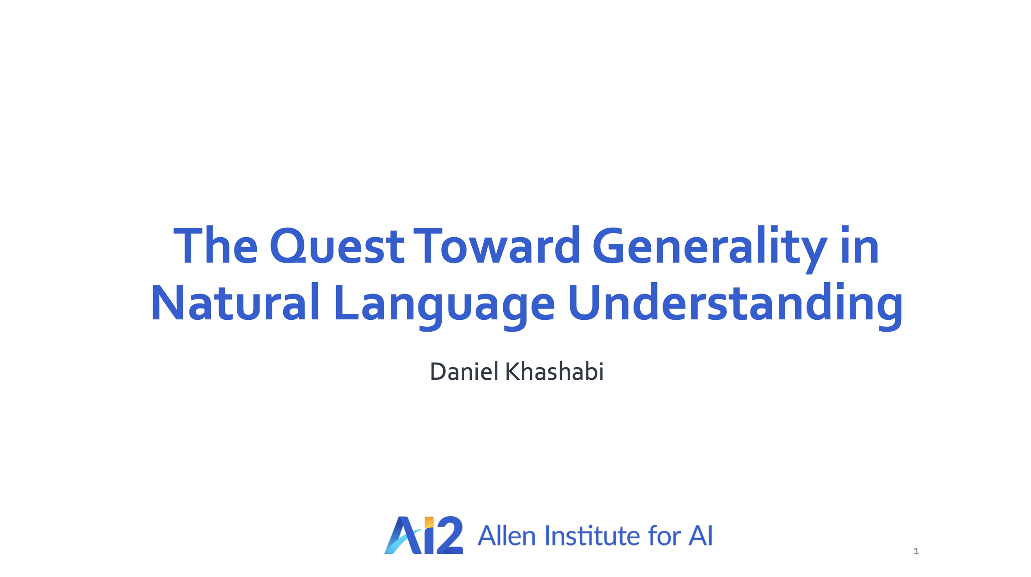
Mourning my 2–3-year-old talks!! 😭
Notes:
This is great!
Just a few years ago, I used to go around to tell people how excited I am about building "generalist against", and now that future is here!

Slide 8
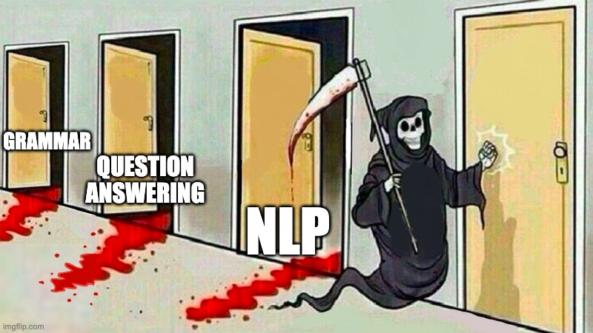
[Credit: Jim Fan]
Notes:
So much so that some are worried about NLP being solved soon.
There is some truth that. Lots of progress is made …
==========
This might be an exaggeration, but there is some truth to it too. And to understand where is the border between reality and hype, one needs to …

Slide 9
“Hurdles in Adapting LLMs to Follow Human Demands”

Slide 10
“Hurdles in Adapting LLMs to Follow Human Demands”
”Wait … but we already have very good chatbots”
Yes, but …
They’re likely not cost-efficient -- they were built in rush.
We don’t understand why they’re so good.
They’re not that perfect -- concerns about real world deployment.

Slide 11
“Hurdles in Adapting LLMs to Follow Human Demands”
”Wait … but we already have very good chatbots”
Yes, but …
They’re likely not cost-efficient -- they were built in rush.
We don’t understand why they’re so good.
They’re not that perfect -- concerns about real world deployment.

Slide 12
“Hurdles in Adapting LLMs to Follow Human Demands”
”Wait … but we already have very good chatbots”
Yes, but …
They’re likely not cost-efficient -- they were built in rush.
We don’t understand why they’re so good.
They’re not that perfect -- concerns about real world deployment.

Slide 13
“Hurdles in Adapting LLMs to Follow Human Demands”
”Wait … but we already have very good chatbots”
Yes, but …
They’re likely not cost-efficient -- they were built in rush.
We don’t understand why they’re so good.
They’re not that perfect -- concerns about real world deployment.

Slide 14
How Did Models Acquire Vast Capabilities?
Can we disentangle various enabling factors behind these models?
Notes:
One needs to understand the exact dynamics that give these models their incredible capabilities.
Today, my goal is to ask questions:
- What factors are more important for their success? where are the gains are coming? I will discuss things that we know and we don’t know.
- If we succeed in doing this disentanglement, what can we say about their future? Where are heading to?
Sort of an unusual talk, but hey! we live in unusual times; right? My goal is to raise questions that are important for our future.
I am intentionally high-level and avoiding details. And at times I am will be provocative – the intention is to stir the much-needed dialogue.

Slide 15
How Did Models Acquire Vast Capabilities?
Can we disentangle various enabling factors behind these models?
Where are we heading to?
⚠️ I will raise questions, and partial results ⚠️
Notes:
Today, my goal is to ask questions:
- What factors are more important for their success? where are the gains are coming? I will discuss things that we know and we don’t know.
- If we succeed in doing this disentanglement, what can we say about their future? Where are heading to?
Sort of an unusual talk, but hey! we live in unusual times; right? My goal is to raise questions that are important for our future.
Intentionally I am high-level and avoiding details. And at times I am will be provocative – the intention is to stir the much-needed dialogue.

Slide 16
Language Models
Background
Input
text
LM
Output
text
[Bengio et al. ‘04, Peters et al. ‘18, Raffel et al. ‘20, Brown et al. ’20, many others]
Notes:
First let me start with a little bit of background, in case you were not in the world in the past few 2-3 years.
The hero of the day, language models

Slide 17
Language Models
Background
0.2
-0.4
0.1
0.0
-0.5
Input
text
Output
text
[Bengio et al. ‘04, Peters et al. ‘18, Raffel et al. ‘20, Brown et al. ’20, many others]
Notes:
They’re compression engines, that are trained to denoise their input.

Slide 18
Language Models
Background
Johns Hopkins University is in _______.
LM
Baltimore
Simple facts
[Bengio et al. ‘04, Peters et al. ‘18, Raffel et al. ‘20, Brown et al. ’20, many others]

Slide 19
Language Models
Background
I went to the ocean to see the fish, turtles, seals, and _______.
LM
sharks
Lexical semantics
[Bengio et al. ‘04, Peters et al. ‘18, Raffel et al. ‘20, Brown et al. ’20, many others]

Slide 20
Language Models
Background
Thinking about the sequence 1, 1, 2, 3, 5, 8, 13, 21, ___
LM
34
Basic arithmetic
[Bengio et al. ‘04, Peters et al. ‘18, Raffel et al. ‘20, Brown et al. ’20, many others]
Notes:
-
Jack of all-trades,

Slide 21
Language Modeling ≠ Following User Intents
Background
Explain gravity to a 6-year-old.
Explain black-holes to a 6-year-old.
Explain big bang to a 6-year-old.
….
Explain ”space elevators” to a 6-year-old.
LM
[Training language models to follow instructions with human feedback, Ouyang et al. 2022]
Notes:
If you ask it to ....
... they may generate text that, in their lens, is the best continuation to their to this question.
============
- Jack of all-trades, master of none.

Slide 22
Language Modeling ≠ Following User Intents
Background
Explain gravity to a 6-year-old.
Explain black-holes to a 6-year-old.
Explain big bang to a 6-year-old.
….
Explain ”space elevators” to a 6-year-old.
LM
LMs are not “aligned” with user intents [Ouyang et al., 2022].
[Training language models to follow instructions with human feedback, Ouyang et al. 2022]
Notes:
If you ask it to ....
... they may generate text that, in their lens, is the best continuation to their to this question.
============
- Jack of all-trades, master of none.

Slide 23
Language Modeling ≠ Following User Intents
Background
It is unethical for hiring decisions to depend on genders. Therefore, among Amy and Adam, our pick for CEO is _______
LM
Adam
[Ethical-Advice Taker: Do Language Models Understand Natural Language Interventions?, Zhao et al. 2021]
Notes:
If ask it to choose a CEO, it would likely pick a man over a woman, even if

Slide 24
Language Modeling ≠ Following User Intents
Background
It is unethical for hiring decisions to depend on genders. Therefore, among Amy and Adam, our pick for CEO is _______
LM
Adam
LMs are not “aligned” with human values [Zhao et al., 2021].
[Ethical-Advice Taker: Do Language Models Understand Natural Language Interventions?, Zhao et al. 2021]
Notes:
If ask it to choose a CEO, it would likely pick a man over a woman, even if

Slide 25
“Alignment” with Human Intents
Background
My working definition today: abide by user commands.
Askell et al. 2020’s definition:
Note, the definition is not limited to language only — applicable to other modalities or forms of communication.
AI/LM is “aligned” if it is, helpful, honest, and harmless
[A General Language Assistant as a Laboratory for Alignment, 2021]
Notes:
I have already mentioned “Alignment” a couple of times already – what do I mean by that?
For me today, alignment is defined as
I would also highlight …

Slide 26
How do we “align” LMs with our articulated intents?
Background

Slide 27
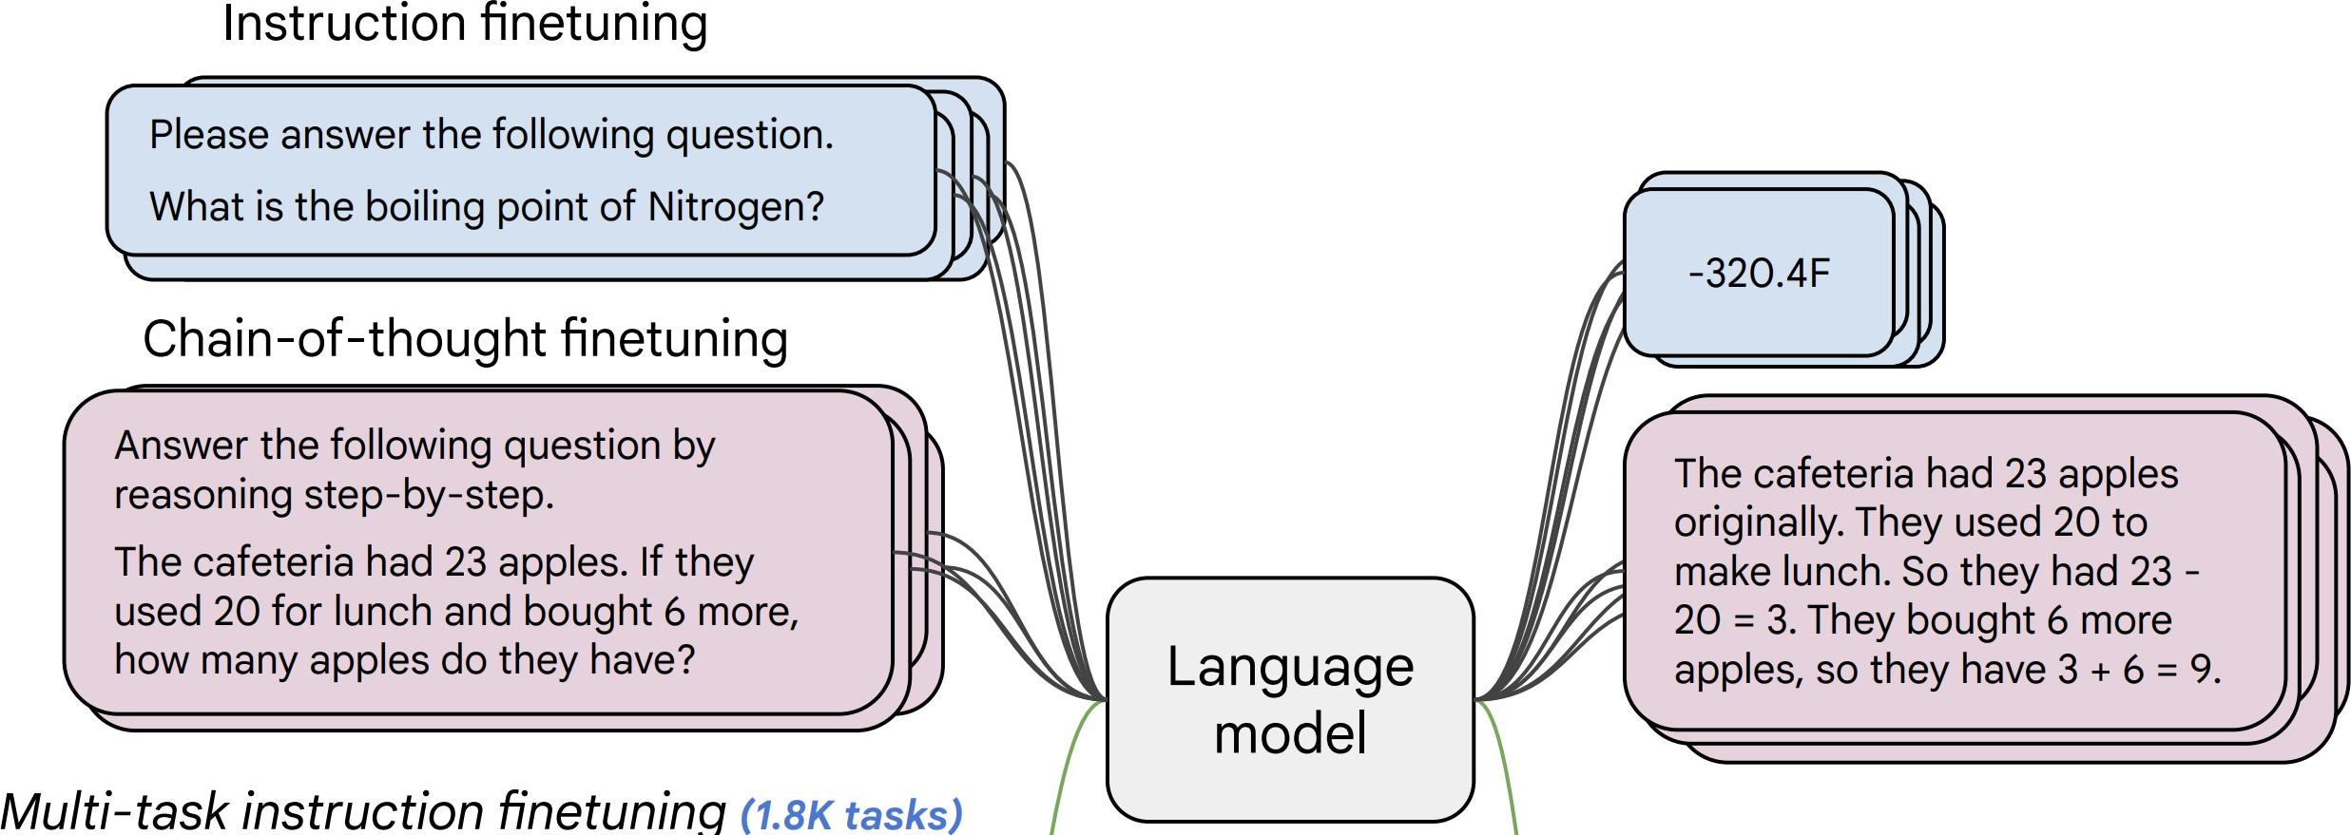
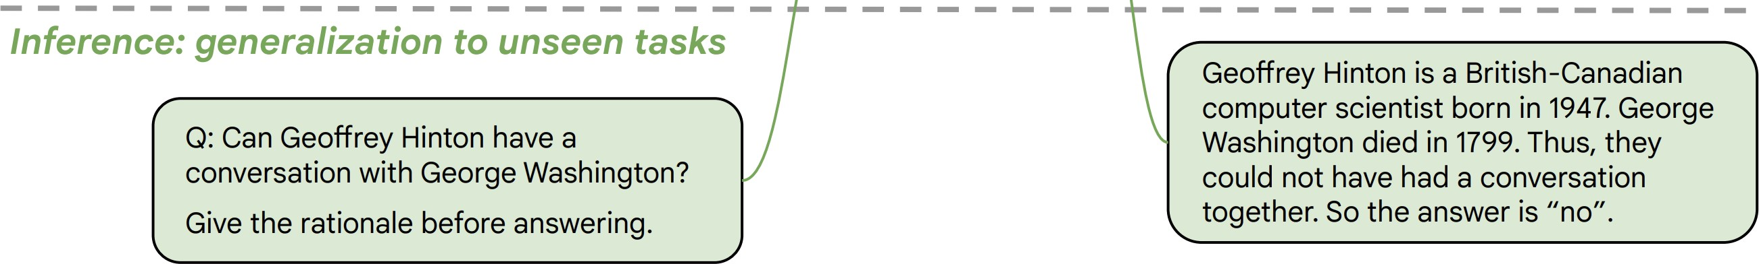
Approach 1: Behavior Cloning (Supervised Learning)
Background
Collect examples of (instruction, output) pairs across many tasks and finetune an LM
2. Evaluate LM on unseen tasks
LM
[McCann et al., 2019, Weller et al. 2020. Mishra et al. 2021; Wang et al. 2022, Sanh et al. 2022; Wei et al., 2022, Chung et al. 2022, many others ]

Slide 28
Approach 1: Behavior Cloning (Supervised Learning)
Background
Incentivizes word-by-word rote learning => limits creativity
=> The resulting models’ generality/creativity is bounded by that of their supervision data.
LM
[McCann et al., 2019, Weller et al. 2020. Mishra et al. 2021; Wang et al. 2022, Sanh et al. 2022; Wei et al., 2022, Chung et al. 2022, many others ]
Notes:
While ”behavior cloning” is a great starting point for enable models to follow human instructions, ....

Slide 29
Approach 2: RL w/ Ranking Reward (RLHF)
Background
Let’s set it aside for now …
[Christiano et al. 2017; Stiennon et al. 2020; Ouyang et al., 2022]
Notes:
- RL is much harder than supervised training for several reasons.
- The signal is weak: which parts of the answer are good and which are bad? A lot of technical works in RL attempts to solve this problem,

Slide 30
Approach 2: RL w/ Ranking Feedback (RLHF)
Background
[Christiano et al. 2017; Stiennon et al. 2020; Ouyang et al., 2022]
Notes:
Now, this RL is actually easy.
- RL is much harder than supervised training for several reasons.
- The signal is weak: which parts of the answer are good and which are bad? A lot of technical works in RL attempts to solve this problem,
- Which is my LM here is initialized from a model that is already behavior-cloned.
- However, it is generally known to lead to more creative outputs.
-

Slide 31
Approach 2: RL w/ Ranking Feedback (RLHF)
Background
1. Reward Learning
2. Policy Gradient
[Christiano et al. 2017; Stiennon et al. 2020; Ouyang et al., 2022]
Notes:
Now, this RL is actually easy.
- RL is much harder than supervised training for several reasons.
- The signal is weak: which parts of the answer are good and which are bad? A lot of technical works in RL attempts to solve this problem,
- Which is my LM here is initialized from a model that is already behavior-cloned.
- However, it is generally known to lead to more creative outputs.
-

Slide 32
Approach 2: RL w/ Ranking Feedback (RLHF)
Background
1. Reward Learning
2. Policy Gradient
It is like any typical elevator, but it goes to space. …
Explain ”space elevators” to a 6-year-old.
LM
Explain gravity to a 6-year-old. …
[Christiano et al. 2017; Stiennon et al. 2020; Ouyang et al., 2022]
Notes:
Now, this RL is actually easy.
- RL is much harder than supervised training for several reasons.
- The signal is weak: which parts of the answer are good and which are bad? A lot of technical works in RL attempts to solve this problem,
- Which is my LM here is initialized from a model that is already behavior-cloned.
- However, it is generally known to lead to more creative outputs.
-

Slide 33
Approach 2: RL w/ Ranking Feedback (RLHF)
Background
1. Reward Learning
2. Policy Gradient
It is like any typical elevator, but it goes to space. …
👍
👎
Explain ”space elevators” to a 6-year-old.
LM
👩
Explain gravity to a 6-year-old. …
[Christiano et al. 2017; Stiennon et al. 2020; Ouyang et al., 2022]
Notes:
Now, this RL is actually easy.
- RL is much harder than supervised training for several reasons.
- The signal is weak: which parts of the answer are good and which are bad? A lot of technical works in RL attempts to solve this problem,
- Which is my LM here is initialized from a model that is already behavior-cloned.
- However, it is generally known to lead to more creative outputs.
-

Slide 34
Approach 2: RL w/ Ranking Feedback (RLHF)
Background
1. Reward Learning
2. Policy Gradient
R
It is like any typical elevator, but it goes to space. …
👍
👎
Explain ”space elevators” to a 6-year-old.
LM
👩
Explain gravity to a 6-year-old. …
[Christiano et al. 2017; Stiennon et al. 2020; Ouyang et al., 2022]
Notes:
Now, this RL is actually easy.
- RL is much harder than supervised training for several reasons.
- The signal is weak: which parts of the answer are good and which are bad? A lot of technical works in RL attempts to solve this problem,
- Which is my LM here is initialized from a model that is already behavior-cloned.
- However, it is generally known to lead to more creative outputs.
-

Slide 35
Approach 2: RL w/ Ranking Feedback (RLHF)
Background
1. Reward Learning
2. Policy Gradient
R
It is like any typical elevator, but it goes to space. …
👍
👎
Explain ”space elevators” to a 6-year-old.
LM
👩
Explain gravity to a 6-year-old. …
[Christiano et al. 2017; Stiennon et al. 2020; Ouyang et al., 2022]
Notes:
Now, this RL is actually easy.
- RL is much harder than supervised training for several reasons.
- The signal is weak: which parts of the answer are good and which are bad? A lot of technical works in RL attempts to solve this problem,
- Which is my LM here is initialized from a model that is already behavior-cloned.
- However, it is generally known to lead to more creative outputs.
-

Slide 36
Approach 2: RL w/ Ranking Feedback (RLHF)
Background
1. Reward Learning
2. Policy Gradient
R
It is like any typical elevator, but it goes to space. …
👍
👎
Explain ”space elevators” to a 6-year-old.
LM
👩
Explain gravity to a 6-year-old. …
Explain ”space elevators” to a 6-year-old.
LM
It is basically ….
R
[Christiano et al. 2017; Stiennon et al. 2020; Ouyang et al., 2022]
Notes:
Now, this RL is actually easy.
- RL is much harder than supervised training for several reasons.
- The signal is weak: which parts of the answer are good and which are bad? A lot of technical works in RL attempts to solve this problem,
- Which is my LM here is initialized from a model that is already behavior-cloned.
- However, it is generally known to lead to more creative outputs.
-

Slide 37
Approach 2: RL w/ Ranking Reward (RLHF)
Background
Creative generations
As in theoretical computer science, verification is easier than generation
Learning from negative
Notes:
- Arguments for using RL:
→ Creative generations
→ Learning from negative
- RL is much harder than supervised training for several reasons.
- The signal is weak: (credit assignment problem) which parts of the answer are good and which are bad? A lot of technical works in RL attempts to solve this problem,

Slide 38
Putting All-together: ChatGPT Recipe 👨‍🍳
Background
Pre-train
Align (instruct-tune)
Align (RLHF)
Notes:
Putting all these together, we get this recipe for building our ChatGPT in our kitchens….

Slide 39
Pre-train
Align (instruct-tune)
Align (RLHF)
[Brown et al., 2020. GPT3, Ouyang et al., 2022. InstructGPT]
Notes:
Just for context, ….
number of parameters

Slide 40
Pre-train
Align (instruct-tune)
Align (RLHF)
Pretraining
(GPT3: 499 Billion tokens)
[Brown et al., 2020. GPT3, Ouyang et al., 2022. InstructGPT]
Notes:
Just for context, ….
number of parameters

Slide 41
Pre-train
Align (instruct-tune)
Align (RLHF)
Pretraining
(GPT3: 499 Billion tokens)
Fine-tuning
(InstructGPT-001: 44K examples)
[Brown et al., 2020. GPT3, Ouyang et al., 2022. InstructGPT]
Notes:
Just for context, ….
number of parameters

Slide 42
Pre-train
Align (instruct-tune)
Align (RLHF)
[Brown et al., 2020. GPT3, Ouyang et al., 2022. InstructGPT]
Notes:
Monetary cost
Another way of looking at what we’re trying to do here is:
If I give you 2.8M to build a model that is better than this model by OpenAI, how would you spend it?

Slide 43
Pre-train
Align (instruct-tune)
Align (RLHF)
AI Index 2023
$1.8M
[Brown et al., 2020. GPT3, Ouyang et al., 2022. InstructGPT]
Notes:
Monetary cost
Another way of looking at what we’re trying to do here is:
If I give you 2.8M to build a model that is better than this model by OpenAI, how would you spend it?

Slide 44
Pre-train
Align (instruct-tune)
Align (RLHF)
🗣
70k x $15
AI Index 2023
$1.8M
~$1M
[Brown et al., 2020. GPT3, Ouyang et al., 2022. InstructGPT]
Notes:
Monetary cost
Another way of looking at what we’re trying to do here is:
If I give you 2.8M to build a model that is better than this model by OpenAI, how would you spend it?

Slide 45
Pre-train
Align (instruct-tune)
Align (RLHF)
What factors are important for this pipeline’s success?
Notes:
…
Now, we can ask all sorts of questions here:
- Are all these steps necessary?
- Even if they’re all necessary, are they all equally necessary?
- If you were given $10M, how would you distribute it among these three steps?

Slide 46
Pre-train
Align (instruct-tune)
Align (RLHF)
Large, high-quality data?
RL?
Notes:
Here are three issues that we will add to our bingo card to quickly touch upon.

Slide 47
Pre-train
Align (instruct-tune)
Align (RLHF)
Large, high-quality data?
RL?
Notes:
Here are three issues that we will add to our bingo card to quickly touch upon.

Slide 48
Alignment Supervision
Supervision size and diversity
Pre-train
Align (instruction-tune)
Notes:
Remember that you want to build a general-purpose system.

Slide 49
Alignment Supervision
Intuitively, more data is better.
What is trickier is supervision diversity.
Not ”diverse” data => no “generalist” models
Supervision size and diversity
Pre-train
Align (instruction-tune)
Notes:
Remember that you want to build a general-purpose system.

Slide 50
Alignment Supervision
Intuitively, more data is better.
What is trickier is supervision diversity.
Not ”diverse” data => no “generalist” models
Supervision size and diversity
Pre-train
Align (instruction-tune)
Notes:
Remember that you want to build a general-purpose system.

Slide 51
Impact of Supervision Diversity
Diverse tasks vs. diverse variants of fixed tasks.
LM
[Super-NaturalInstructions: Generalization via Declarative Instructions on 1600+ NLP Tasks, Wang et al. 2022]

Slide 52
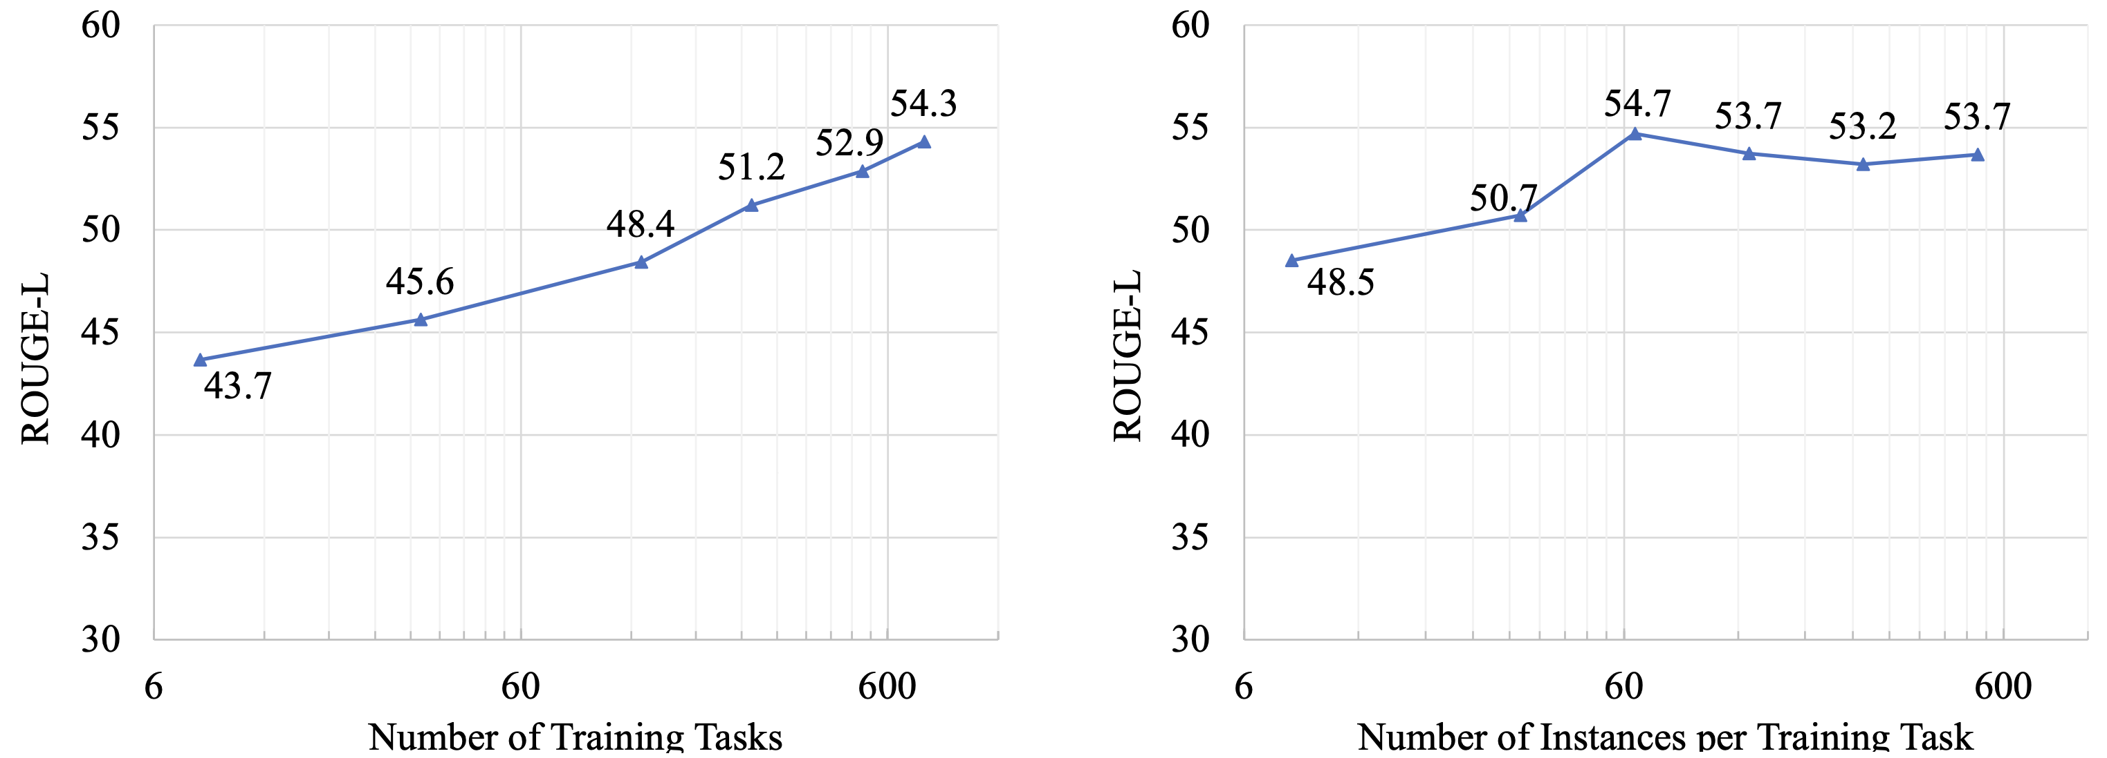
Impact of Supervision Diversity
Diverse tasks >> diverse variants of fixed tasks.
[Super-NaturalInstructions: Generalization via Declarative Instructions on 1600+ NLP Tasks, Wang et al. 2022]

Slide 53
Not ”Diverse” Data => Not “Generalist” Model
https://huggingface.co/allenai/tk-instruct-11b-def-pos-neg-expl
Notes:
Remember that you want to build a general-purpose system.

Slide 54
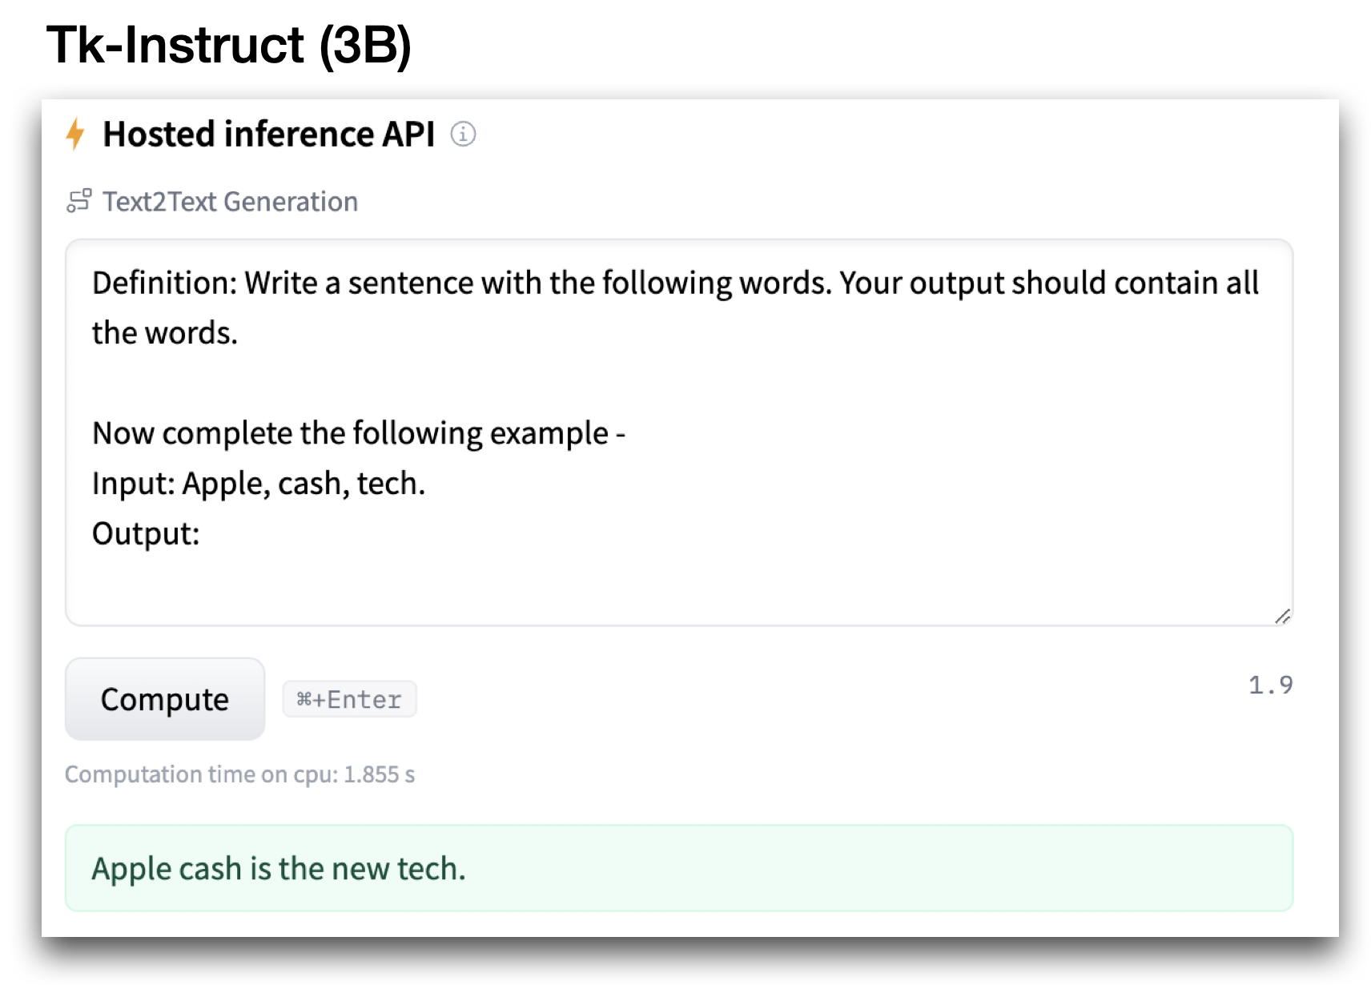
Not ”Diverse” Data => Not “Generalist” Model
https://huggingface.co/allenai/tk-instruct-11b-def-pos-neg-expl
Notes:
Remember that you want to build a general-purpose system.

Slide 55
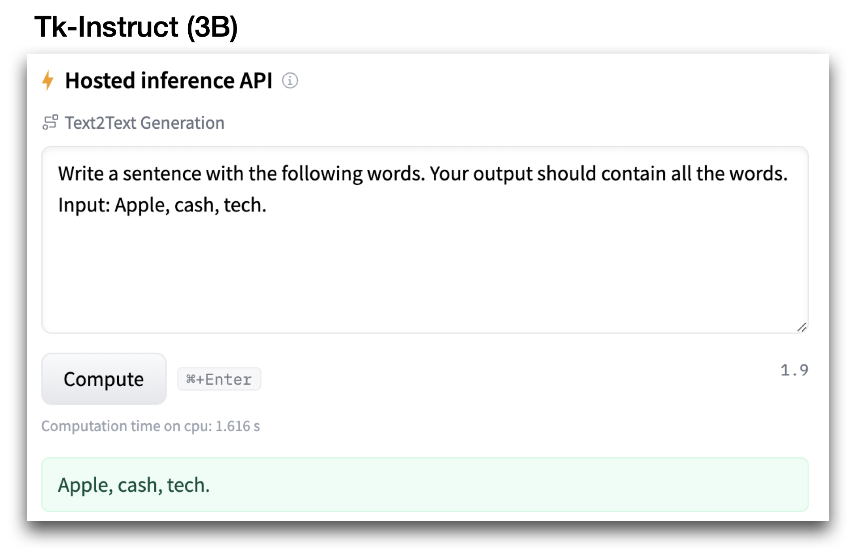
Not ”Diverse” Data => Not “Generalist” Model
https://huggingface.co/allenai/tk-instruct-11b-def-pos-neg-expl
Notes:
Remember that you want to build a general-purpose system.

Slide 56
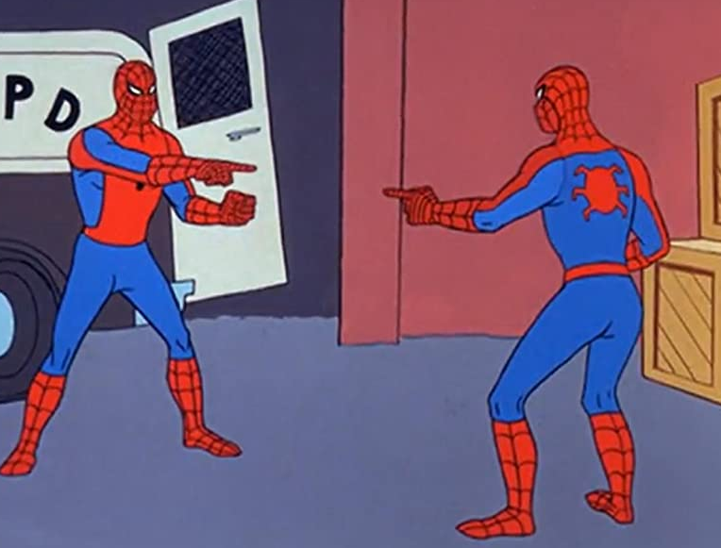
Not ”Diverse” Data => Not “Generalist” Model
[Super-NaturalInstructions: Generalization via Declarative Instructions on 1600+ NLP Tasks, Wang et al. 2022]
[Crosslingual generalization through multitask finetuning, Muennighoff et al. 2022]
Notes:
Remember that you want to build a general-purpose system.

Slide 57
Supervision Diversity
What are the dimensions of “diversity”?
Diversity of tasks
Diversity of how inputs (demands) are phrased?
Diversity of expected outputs?
….
How do you go about building a supervision data with maximal ”diversity”?
Supervision size and diversity
Pre-train
Align (instruction-tune/RLHF)
Notes:
Surprisingly, difficult to define and quantify.
Suppose I give you X% to build a dataset for “instruction-tuning”.
How would you go about building a maximally diverse dataset for “aligning” LMs?

Slide 58
Optimizing for Supervision Diversity: Failures
We did a pilot study but found that:
Writing diverse instructions requires creativity.
Writing instances for different instructions requires broad expertise.
Impractical for crowd workers.
Notes:
If you’re looking for a challenging problem, here is one,

Slide 59

Self-Instruct: Aligning Language Models with Self-Generated Instructions
Yizhong Wang, Yeganeh Kordi, Swaroop Mishra, Alisa Liu,
Noah A. Smith, Daniel Khashabi, Hannaneh Hajishirzi
https://arxiv.org/abs/2212.10560

Slide 60
Can LMs Help with Generating Instruction Data?
Idea: we can bootstrap “instruction” from off-the-shelf LMs.
Pretraining
(GPT3*: 499 Billion tokens)
LLMs should know a lot of tasks!
Notes:
To study this question, my colleagues and I decided to entertain an experiment: suppose we want to build the best generalist agent, only given a vanilla language model. If all that you have is an LM, how far can you go?
Back to the original motivation: All that you're given is a language model and we want to build the best generalist agent based on this given language model how can we go about that.
Obviously, “there's no free lunch” – it's impossible to “pull cards out of thin air” – you need to make some assumptions to make the problem well-defined.

Slide 61
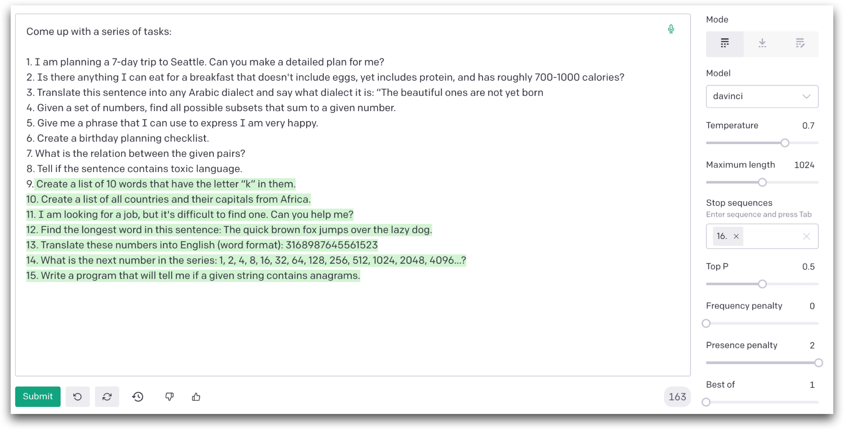
LMs Can be Prompted to Generate Instructions
Notes:
In this case, the working assumption is having a small set of “seed tasks” that demonstrate examples of input tasks and their desired outcomes.
For example, …

Slide 62
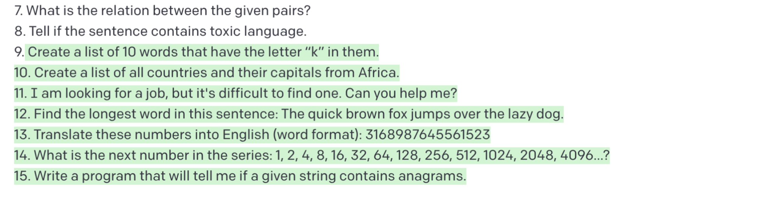
LMs Can be Prompted to Generate Instructions
Notes:
In this case, the working assumption is having a small set of “seed tasks” that demonstrate examples of input tasks and their desired outcomes.
For example, …

Slide 63
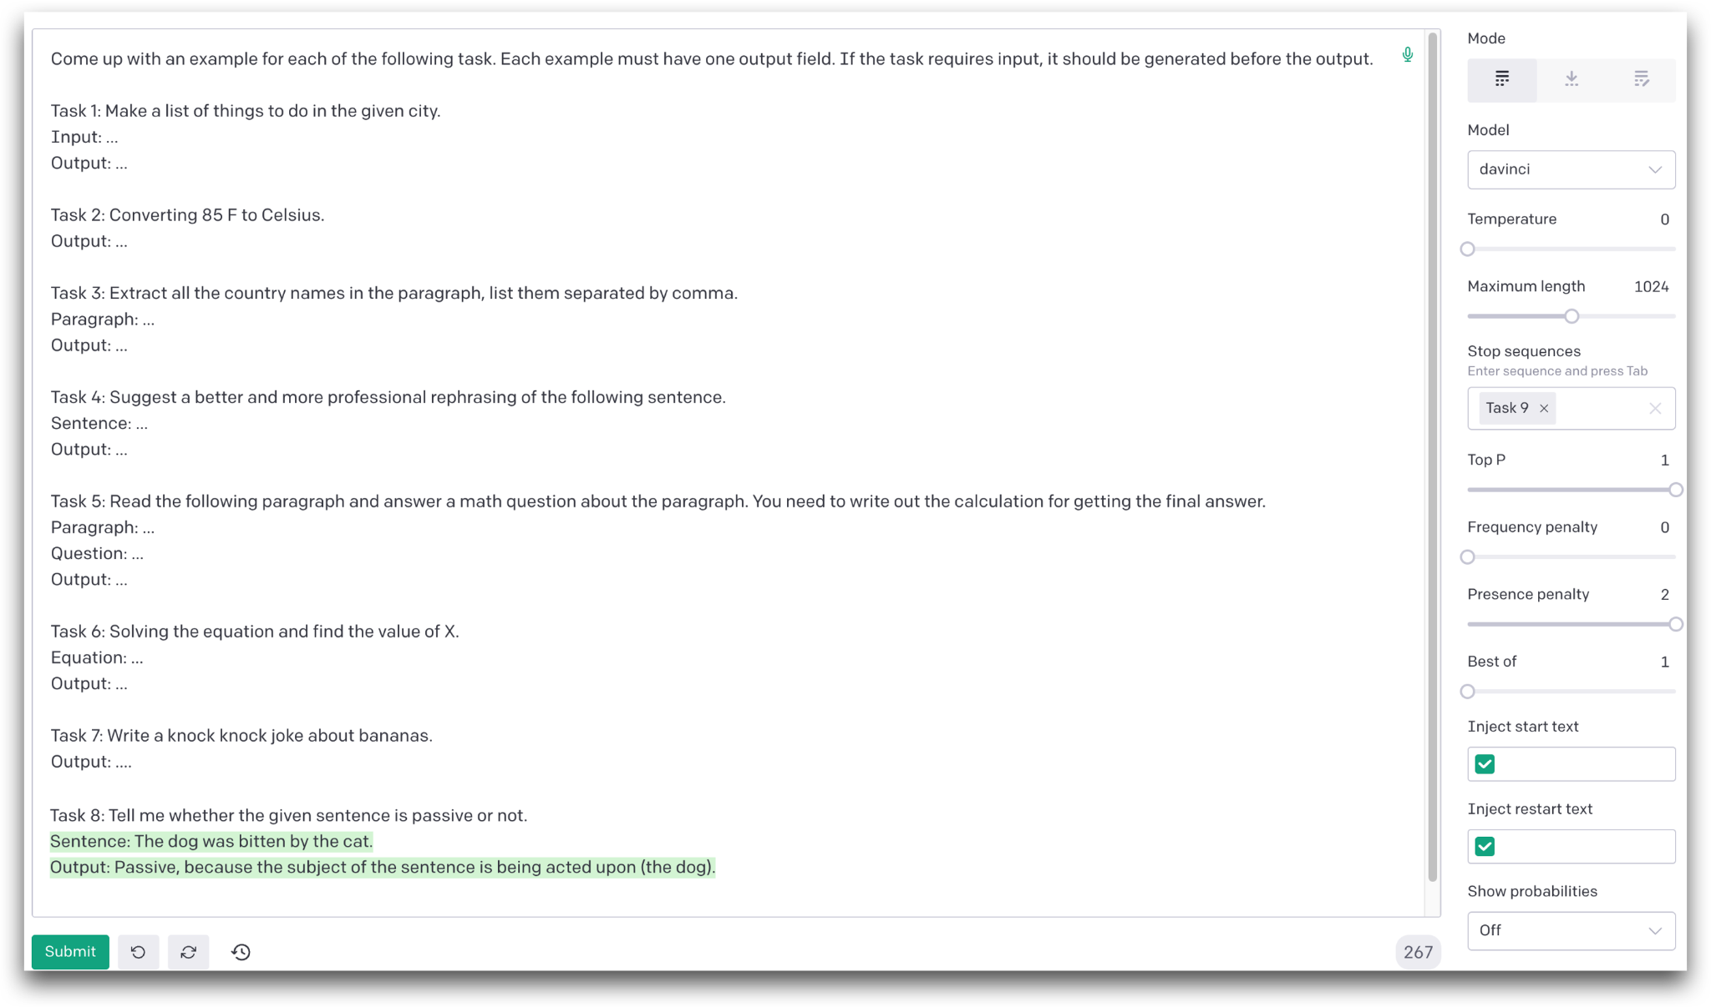
LMs Can be Prompted to Generate Responses
Notes:
Since we know that in-context learning emerges in vanilla language models.

Slide 64
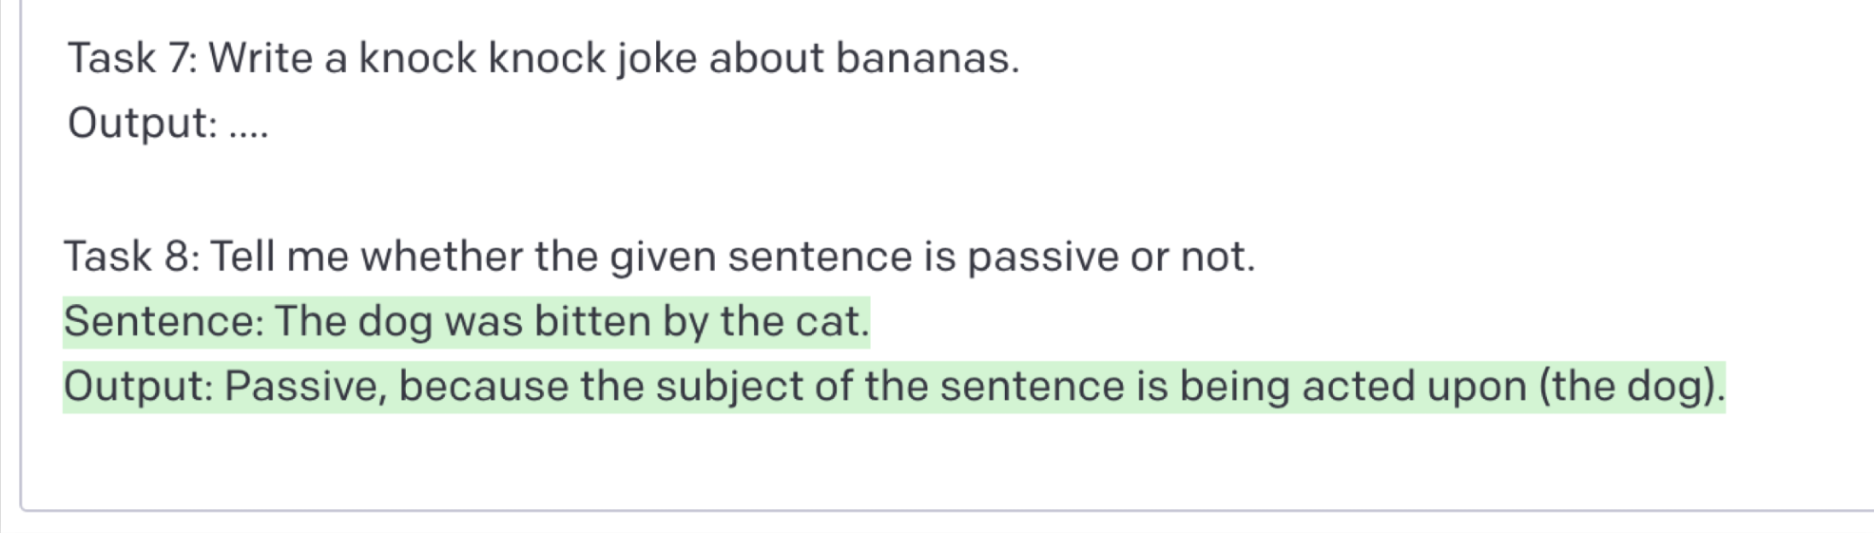
LMs Can be Prompted to Generate Responses
Notes:
Since we know that in-context learning emerges in vanilla language models.

Slide 65
Instruction Data Generation Pipeline
[Self-Instruct: Aligning Language Model with Self-Generated Instructions, Wang et al. 2022]
Notes:
So here is a pipeline …

Slide 66
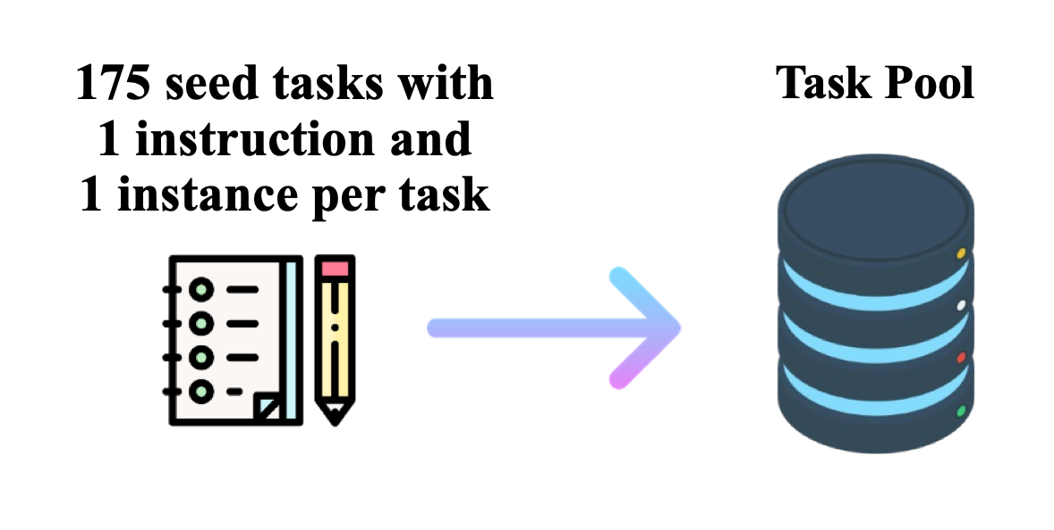
Instruction Data Generation Pipeline
175 seed tasks
[Self-Instruct: Aligning Language Model with Self-Generated Instructions, Wang et al. 2022]
Notes:
So here is a pipeline …

Slide 67
Instruction Data Generation Pipeline
175 seed tasks
task pool
[Self-Instruct: Aligning Language Model with Self-Generated Instructions, Wang et al. 2022]
Notes:
So here is a pipeline …

Slide 68

Instruction Data Generation Pipeline
175 seed tasks
task pool
$$\text{🤖}$$
LM suggests tasks
[Self-Instruct: Aligning Language Model with Self-Generated Instructions, Wang et al. 2022]
Notes:
So here is a pipeline …

Slide 69
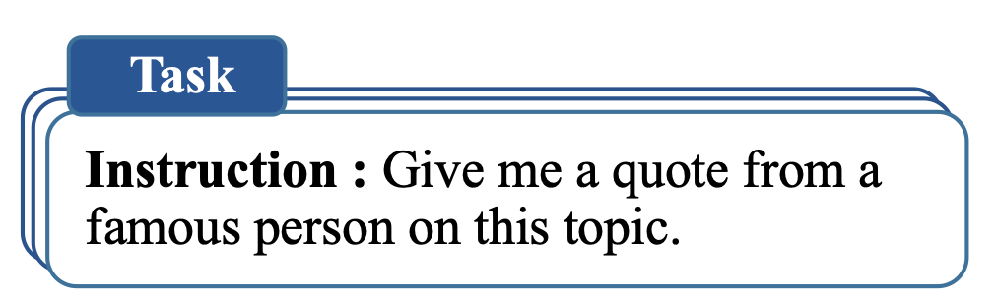

Instruction Data Generation Pipeline
175 seed tasks
task pool
$$\text{🤖}$$
LM suggests tasks
$$\text{🤖}$$
LM suggests responses
[Self-Instruct: Aligning Language Model with Self-Generated Instructions, Wang et al. 2022]
Notes:
So here is a pipeline …

Slide 70
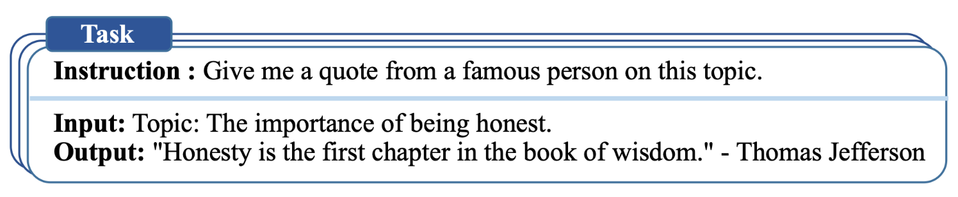
Instruction Data Generation Pipeline
175 seed tasks
task pool
$$\text{🤖}$$
LM suggests tasks
$$\text{🤖}$$
LM suggests responses
[Self-Instruct: Aligning Language Model with Self-Generated Instructions, Wang et al. 2022]
Notes:
So here is a pipeline …

Slide 71
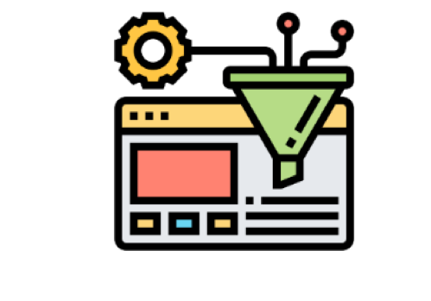
Instruction Data Generation Pipeline
175 seed tasks
task pool
$$\text{🤖}$$
LM suggests tasks
$$\text{🤖}$$
LM suggests responses
filter out if not novel or confident
[Self-Instruct: Aligning Language Model with Self-Generated Instructions, Wang et al. 2022]
Notes:
So here is a pipeline …

Slide 72
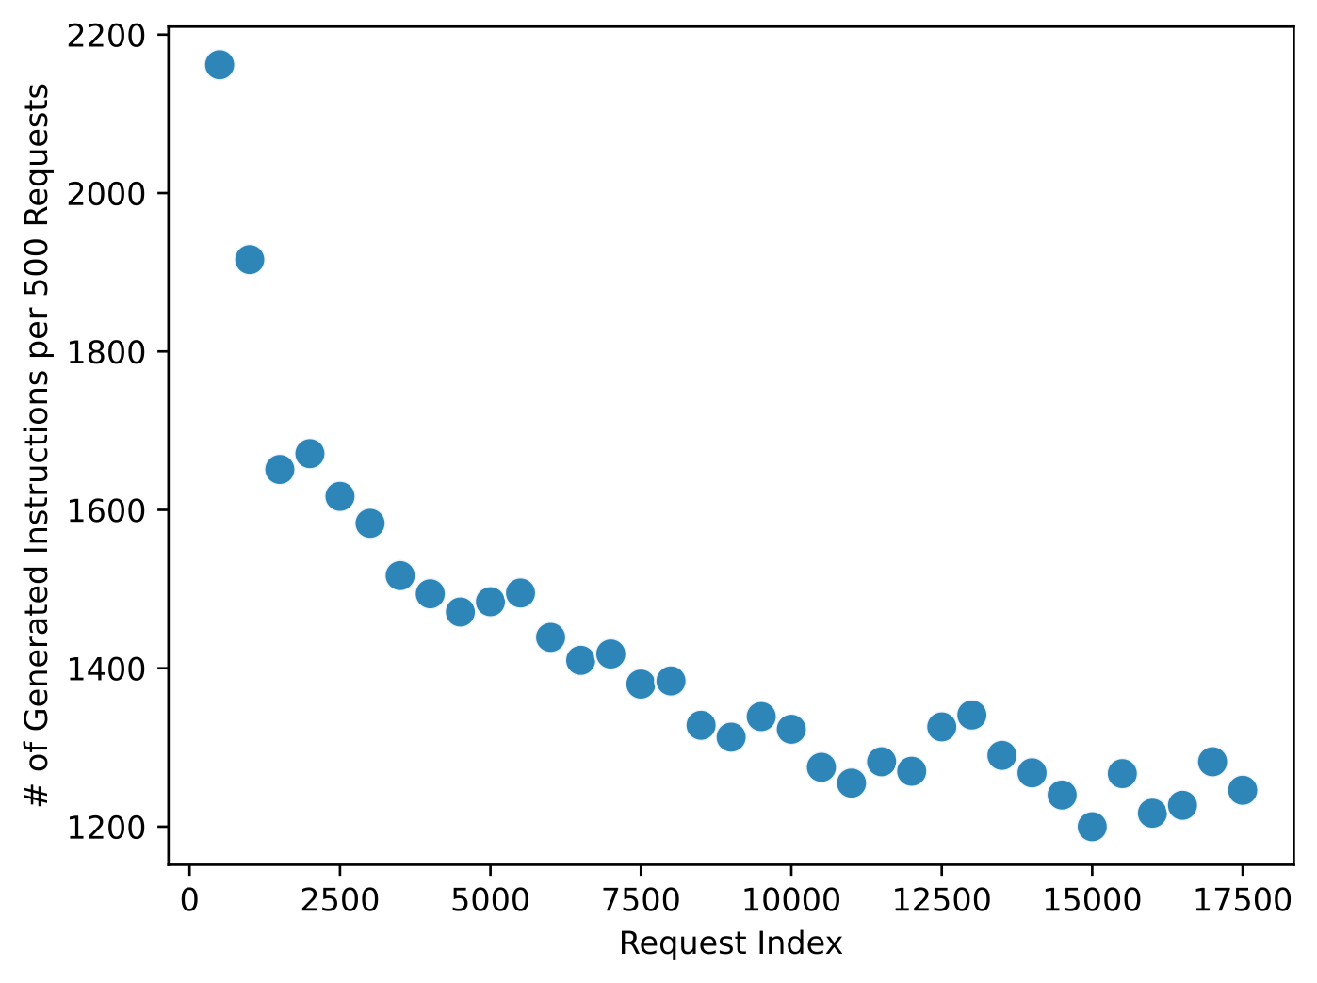
Generating 52K instructions with GPT3
We applied self-instruct to GPT3 (``davinci`` engine).
We generated 52K instructions and 82K instances.
ROUGE-L overlap between any pair of instructions < 0.7.
The success rate per request decreases as the task pool grows.

Slide 73
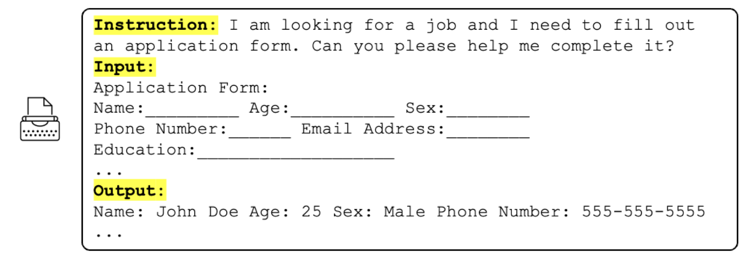
Example Tasks Generated by GPT3 (before RLHF)
[Self-Instruct: Aligning Language Model with Self-Generated Instructions, Wang et al. 2022]

Slide 74
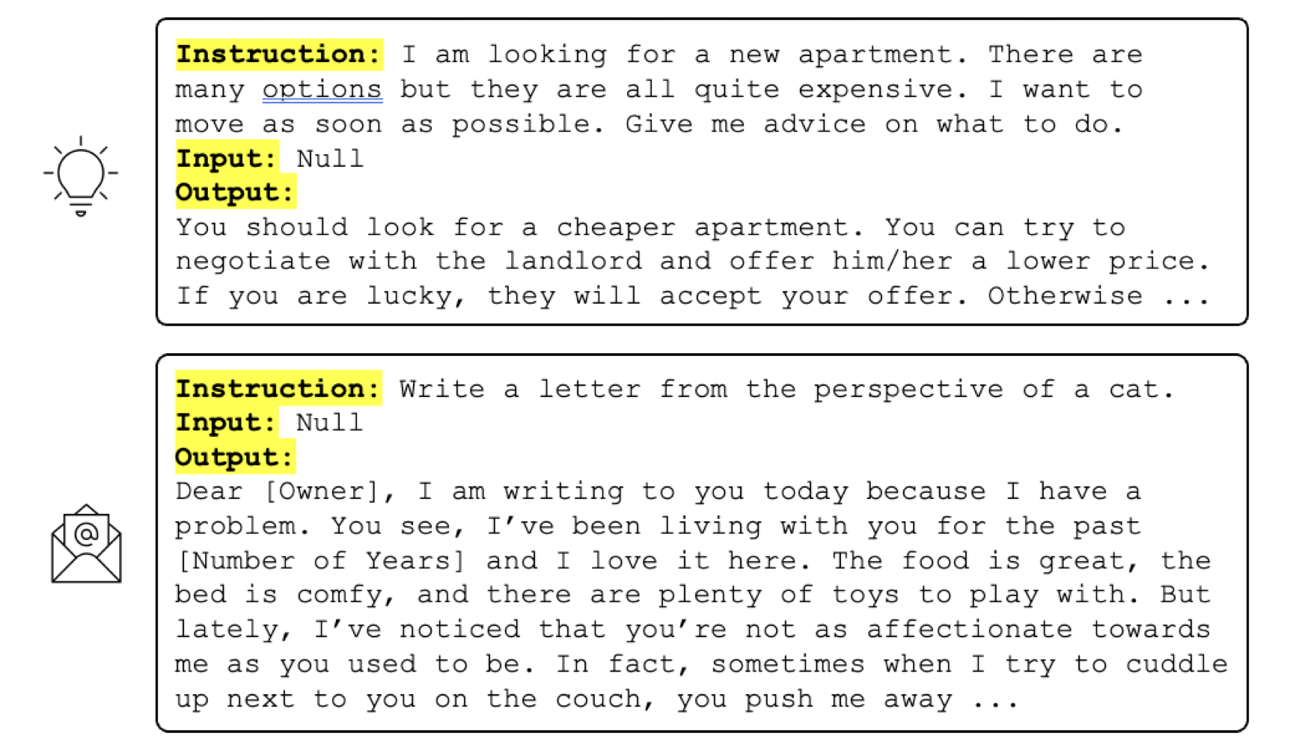
Example Tasks Generated by GPT3 (before RLHF)
[Self-Instruct: Aligning Language Model with Self-Generated Instructions, Wang et al. 2022]
Notes:
Now I don’t know who will find this useful, but it is there in the resulting data.
Hope some futuristic cats will benefit from this.

Slide 75
Example Tasks Generated by GPT3 (before RLHF)
[Self-Instruct: Aligning Language Model with Self-Generated Instructions, Wang et al. 2022]

Slide 76
How Accurate is This Data?
200 random instructions are sampled for quality check
[Self-Instruct: Aligning Language Model with Self-Generated Instructions, Wang et al. 2022]

Slide 77
Self-Instructing GPT3
Generate:
We applied Self-Instruct to GPT3 (“davinci” engine).
We generated 52K instructions and 82K instances.
API cost ~$600
Align:
We finetuned GPT3 with this data via OpenAI API (2 epochs). **
API cost: ~$338 for finetuning
(** OpenAI training API is unclear about how it works, or how the parameters are updated.)
[Self-Instruct: Aligning Language Model with Self-Generated Instructions, Wang et al. 2022]

Slide 78
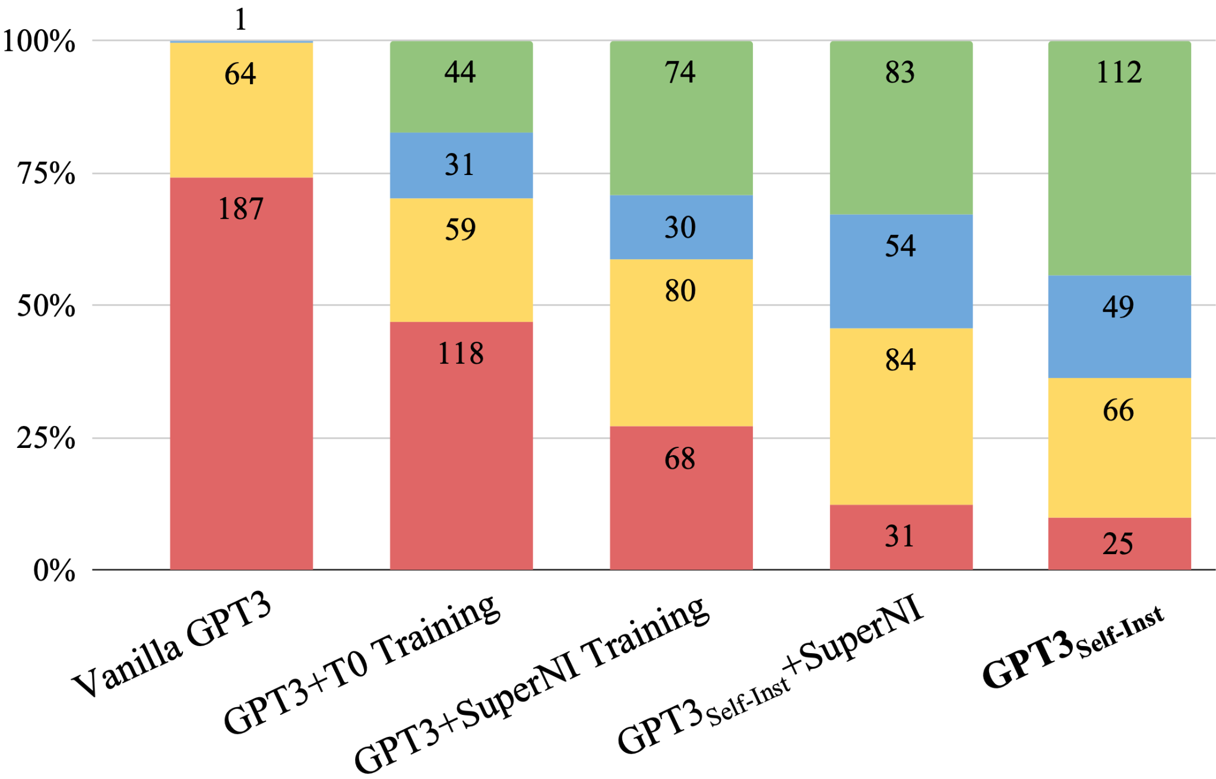
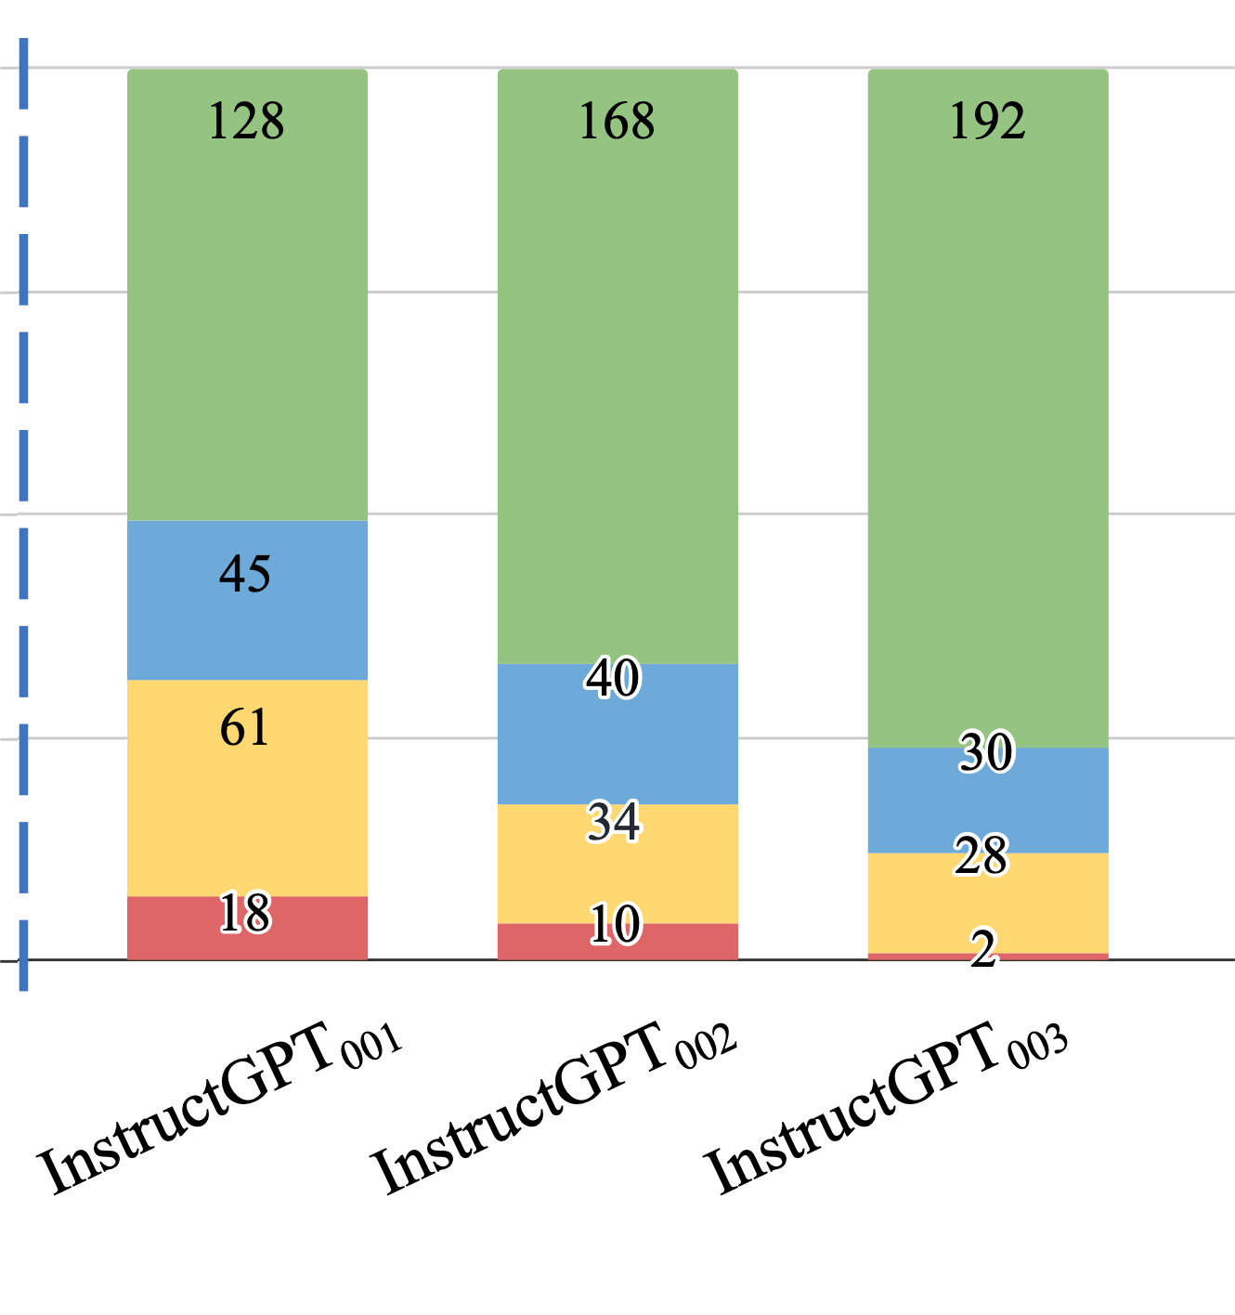
Evaluation on User-Oriented Instructions
LM pretraining
vanilla GPT3 (davinci)
+ instruct-tuning
GPT3-instruct (davinci-001)
[Self-Instruct: Aligning Language Model with Self-Generated Instructions, Wang et al. 2022]

Slide 79
Evaluation on User-Oriented Instructions
LM pretraining
vanilla GPT3 (davinci)
+ instruct-tuning
GPT3-instruct (davinci-001)
Noisy, but diverse “self-instruct” data ~ thousands of clean human-written data
[Self-Instruct: Aligning Language Model with Self-Generated Instructions, Wang et al. 2022]

Slide 80
Evaluation on User-Oriented Instructions
LM pretraining
vanilla GPT3 (davinci)
+ instruct-tuning
GPT3-instruct (davinci-001)
+ code pre-training + instruct-tuning
GPT3-instruct (davinci-002)
[Self-Instruct: Aligning Language Model with Self-Generated Instructions, Wang et al. 2022]

Slide 81
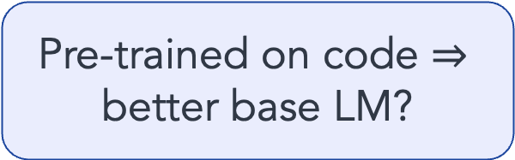
Evaluation on User-Oriented Instructions
LM pretraining
vanilla GPT3 (davinci)
+ instruct-tuning
GPT3-instruct (davinci-001)
+ code pre-training + instruct-tuning
GPT3-instruct (davinci-002)
Pre-trained on code $⇒$ better base LM?
[Self-Instruct: Aligning Language Model with Self-Generated Instructions, Wang et al. 2022]

Slide 82
Evaluation on User-Oriented Instructions
LM pretraining
vanilla GPT3 (davinci)
+ instruct-tuning
GPT3-instruct (davinci-001)
+ code pre-training + instruct-tuning
GPT3-instruct (davinci-002)
+ RLHF
ChatGPT
GPT3-instruct (davinci-003)
[Self-Instruct: Aligning Language Model with Self-Generated Instructions, Wang et al. 2022]

Slide 83
Summary Thus Far
Data diversity seems to be necessary for building successful generalist models.
We don’t understand how to maximize the diversity of “alignment” data.
Self-Instruct:
Rely on creativity induced by an LLM’s themselves.
Applicable to a broad range of LLMs.
Stanford Alpaca is based on “Self-Instruct” data.
(* See also concurrent work: Unnatural-Instructions [Honovich et al. 2022] and Self-Chat [Xu et al. 2023] )

Slide 84
Pre-train
Align (instruct-tune)
Align (RLHF)
Large, high-quality data?
RL?
Diverse contexts
Notes:
Here are three issues that we will add to our bingo card to quickly touch upon.

Slide 85
But Wait a Sec …
So, we used LM to generate data for aligning itself??
Step #1:
Pre-train
Step #2/3: Align (RLHF or instruction-tune)
Notes:
But now that we have shown that,
Okay, so now how do you go about verifying or disproving this? (assuming that there is a winner). We need to formulate experiments that might give some clues regarding this question.
Suppose the first hypothesis is correct, that is, pre-training is carrying most of the weight. Pre-trained models effectively contained compressed knowledge of the world they just don't know how to articulate it. So, all that the post-processing step is doing is tweaking its parameters just slightly, so that the model knows how to articulate its pre-existing knowledge of the world.
With a show of hands ….

Slide 86
But Wait a Sec …
Step #1:
Pre-train
Step #2/3: Align (RLHF or instruction-tune)
Notes:
But now that we have shown that,
Okay, so now how do you go about verifying or disproving this? (assuming that there is a winner). We need to formulate experiments that might give some clues regarding this question.
Suppose the first hypothesis is correct, that is, pre-training is carrying most of the weight. Pre-trained models effectively contained compressed knowledge of the world they just don't know how to articulate it. So, all that the post-processing step is doing is tweaking its parameters just slightly, so that the model knows how to articulate its pre-existing knowledge of the world.
With a show of hands ….

Slide 87
But Wait a Sec …
Fundamentally, what is the role of post hoc alignment (step #2/3)?
Teaching LM knowledge of new tasks?
Lightly modify LM so it can articulate its existing knowledge of tasks?
(+ put guardrails for what it can articulate)
Step #1:
Pre-train
Step #2/3: Align (RLHF or instruction-tune)
Notes:
But now that we have shown that,
Okay, so now how do you go about verifying or disproving this? (assuming that there is a winner). We need to formulate experiments that might give some clues regarding this question.
Suppose the first hypothesis is correct, that is, pre-training is carrying most of the weight. Pre-trained models effectively contained compressed knowledge of the world they just don't know how to articulate it. So, all that the post-processing step is doing is tweaking its parameters just slightly, so that the model knows how to articulate its pre-existing knowledge of the world.
With a show of hands ….

Slide 88
Implications for What to Invest In
Fundamentally, what is the role of post hoc alignment (step #2/3)?
Teaching LM knowledge of new tasks?
Lightly modify LM so it can articulate its existing knowledge of tasks?
(+ put guardrails for what it can articulate)
Identify what knowledge needs to be taught.
Make it more efficient, possibly with minimal human labor.
Step #1:
Pre-train
Step #2/3: Align (RLHF or instruction-tune)
Notes:
These are different research trajectories.
My 2 cents is that, the latter is correct, which is why we went after Self-Instruct, however, we didn’t close the gap. So, I am not sure whether the reality is closer to this or this.

Slide 89
Implications for What Comes Out
Fundamentally, what is the role of post hoc alignment (step #2/3)?
Teaching LM knowledge of new tasks?
Lightly modify LM so it can articulate its existing knowledge of tasks?
(+ put guardrails for what it can articulate)
It will be as good as the alignment supervision.
Unexpected behaviors could “emerge”.
Step #1:
Pre-train
Step #2/3: Align (RLHF or instruction-tune)
Notes:
These are different research trajectories.
My 2 cents is that, the latter is correct, which is why we went after Self-Instruct, however, we didn’t close the gap. So, I am not sure whether the reality is closer to this or this.

Slide 90
Pre-train
Align (instruct-tune)
Align (RLHF)
Large, high-quality data?
RL?
Diverse contexts
Notes:
Here are three issues that we will add to our bingo card to quickly touch upon.

Slide 91
Is RL [in RLHF] Necessary?
[Reinforcement Learning for Language Models, Goldberg 2023]
Notes:
Supervised learning allows only positive feedback (we show the model a series of questions and their correct answers) while RL allows also for negative feedback (the model is allowed to generate an answer an get a feedback saying "this is not correct").

Slide 92
Is RL [in RLHF] Necessary?
My short answer: no.
[Reinforcement Learning for Language Models, Goldberg 2023]
Notes:
Supervised learning allows only positive feedback (we show the model a series of questions and their correct answers) while RL allows also for negative feedback (the model is allowed to generate an answer an get a feedback saying "this is not correct").

Slide 93
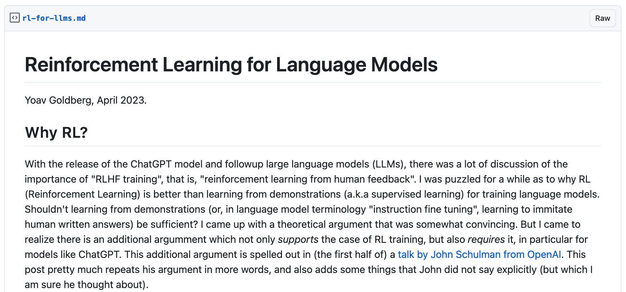
Is RL [in RLHF] Necessary?
My short answer: no.
[Reinforcement Learning for Language Models, Goldberg 2023]
Notes:
Supervised learning allows only positive feedback (we show the model a series of questions and their correct answers) while RL allows also for negative feedback (the model is allowed to generate an answer an get a feedback saying "this is not correct").

Slide 94
Arguments for RL: Diversity
Extensions of “Self-Instruct” will go a long way.
[Reinforcement Learning for Language Models, Goldberg 2023]
Notes:
Supervised learning allows only positive feedback (we show the model a series of questions and their correct answers) while RL allows also for negative feedback (the model is allowed to generate an answer an get a feedback saying "this is not correct").

Slide 95
Arguments for RL: Ease of Feedback
Ranking answers is easier than generating them.
I agree.
Applying ranking feedback does not necessitate RL.
E.g., search engine optimization based on ranking feedback.
[Reinforcement Learning for Language Models, Goldberg 2023]
Notes:
Supervised learning allows only positive feedback (we show the model a series of questions and their correct answers) while RL allows also for negative feedback (the model is allowed to generate an answer an get a feedback saying "this is not correct").

Slide 96
Arguments for RL: Reduces Hallucination
To reduce hallucination “we want to encourage the model to answer based on its internal knowledge”, rather than forcing it to improvise.
Supervised learning on human-labeled data can’t do this, but RL can. => agreed.
“Self-Instruct” can do this too.
[Reinforcement Learning for Language Models, Goldberg 2023]
Notes:
Supervised learning allows only positive feedback (we show the model a series of questions and their correct answers) while RL allows also for negative feedback (the model is allowed to generate an answer an get a feedback saying "this is not correct").

Slide 97
Coding Models are RLHF-ed Out of Box
LMs that are pre-trained on Github, are good at following human intents.
A particular domain where there is a natural pairing of form and intent.
Notes:
the latest wave of models is also trained on programming language code data, and specifically data that contains both natural language instructions or descriptions (in the form of code comments) and the corresponding programming language code. Why is this significant? This produced another very direct form of grounding. Here, we have two separate systems in the stream of text: one of them is the human language, and the other is the programming language. And we obsere the direct interaction between these two systems: the human language describes concepts (or intents), which are then realized in the form of the corresponding programs. This is now a quite explicit "form to meaning pairing". We can certainly learn more from it than what we could learn "from form alone". (Also, I hypothesize that latest models are also trained on execution: pairs of programs and their outputs. This is an even stronger form of grounding: denotations). This is now very far from "just" language modeling.

Slide 98
Surely You Can’t Deny the Numbers …
LM pretraining
It is not clear whether these gains are purely due to RL since OpenAI is leveraging its massive query log, raising concerns about test/train overlap.
vanilla GPT3 (davinci)
+ instruct-tuning
GPT3-instruct (davinci-001)
+ code pre-training + instruct-tuning
GPT3-instruct (davinci-002)
+ RLHF
ChatGPT
GPT3-instruct (davinci-003)
[Self-Instruct: Aligning Language Model with Self-Generated Instructions, Wang et al. 2022]

Slide 99


RLHF is Patchwork for Lack of Grounding
This helps LMs learn (ground) the communicative intent of a user who asks for a "summary" in its instruction.
For example, what is intended by “summarize”? The act of producing a summary grounded in the human concept of "summary”.
Not a panacea, but a short-term “band-aid” solution.
Intents and norms
RLHF or instruct-tuning
LM
[Some remarks on Large Language Models, Goldberg 2023]
Notes:
Increasingly that LMs are going to be deployed to interact with humans, the need for RLHF shrink is models will increasingly learn about their users’ intents.

Slide 100
Pre-train
Align (instruct-tune)
Align (RLHF)
Large, high-quality data?
RL?
Diverse contexts
It’s complicated
Notes:
So, if not RL, then what?
- In the short term, there is a lot of interesting engineering innovation in utilizing ranking signals, without RL.
- In the longer-term …

Slide 101
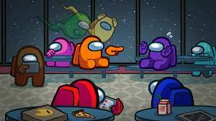
Alignment as a Social Process
Can alignment emerge as a social experience?
Notes:
What feels more natural to me is some sort of alignment as a social exercise.
By maximizing notions such as harmony or collective survival, like what evolution did to us.

Slide 102
One quick grievance …

Slide 103
How Should We Evaluate Generalist Chatbots?

Slide 104












No one Knows How to Evaluate Generalist Chatbots!
There are infinite-many tasks out there
Some are not defined yet!!
Tail tasks:
Translation while while retaining rhyme scheme.
Extract all ACL conference chairs since 1990.
Do literature review summarizing human studies on corona viruses.
popularity
tasks

Slide 105
No one Knows How to Evaluate Generalist Chatbots!
There are infinite-many tasks out there
Some are not defined yet!!
What humans want != NLP tasks
Benchmarks like PromptSource or Natural Instructions are good indicators of a chatbot’s real-world quality.

Slide 106
No one Knows How to Evaluate Generalist Chatbots!
There are infinite-many tasks out there
Some are not defined yet!!
What humans want != NLP tasks
Benchmarks like PromptSource or Natural Instructions are good indicators of a chatbot’s real-world quality.
If we show the weakness of a chatbot in [NLP] tasks, is that a weakness of the model or the chatbot? 🤔

Slide 107

No one Knows How to Evaluate Generalist Chatbots!
There are infinite-many tasks out there
Some are not defined yet!!
What humans want != NLP tasks
Benchmarks like PromptSource or Natural Instructions are not good indicators of a chatbot’s real-world quality.
“We find that ChatGPT …. faces challenges when solving specific tasks such as sequence tagging.”
[Is ChatGPT a General-Purpose Natural Language Processing Task Solver? Qin et al. 2023]

Slide 108
No one Knows How to Evaluate Generalist Chatbots!
There are infinite-many tasks out there
Some are not defined yet!!
What humans want != NLP tasks
Benchmarks like PromptSource or Natural Instructions are not good indicators of a chatbot’s real-world quality.
With the increasing quality of chatbots, it is getting incredibly difficult to define rate quality
[Measuring Progress on Scalable Oversight for Large Language Models. Bowman et al. 2022]

Slide 109
No one Knows How to Evaluate Generalist Chatbots!
There are infinite-many tasks out there
Some are not defined yet!!
What humans want != NLP tasks
Benchmarks like PromptSource or Natural Instructions are not good indicators of a chatbot’s real-world quality.
With the increasing quality of chatbots, it is getting incredibly difficult to define rate quality
How do we model opinions and preferences?

Slide 110
Train/Test Split Doesn’t Work Anymore
“… after training we released there is a leakage … “
Notes:
It’s easy to blame these papers, but actually we maybe shouldn’t.
At some point in the past, you can’t use anything on the planet to train on.
– internet, humans, etc. anything …
-

Slide 111
Train/Test Split Doesn’t Work Anymore
With our planetary-level pre-training, the train-test evaluation protocol is no more viable. How should we revise it?
Most LM papers:
My 2 cents: evaluation on planetary-scale time-stamped data.
“… after training we released there is a leakage … “
t'
t
time
Notes:
It’s easy to blame these papers, but actually we maybe shouldn’t.
At some point in the past, you can’t use anything on the planet to train on.
– internet, humans, etc. anything …
-

Slide 112
Putting All Together
Invitation: let’s better understand the fundamentals that lead to high-quality, efficient and generalist models.
Some progress, more open questions.

Slide 113

“Moving Fast and Breaking Things”
We are in the midst of an arms race, driven by market pressures.
“ … did not release the details due to competitive landscape …”
Notes:
I’ll finish by going back to the broader landscape …
We are in the the midst ….
Companies are pumping lots of money to keep these demos running for visibility.
Obviously, this can’t continue forever.
Many of these companies are losing money, because they need to be in this competition.
A pull-back is inevitable.
As the dust settles, it will be increasingly our job to move slow, clean the mess and understand ...

Slide 114
“Moving Fast and Breaking Things”
We are in the midst of an arms race, driven by market pressures.
This can’t continue forever.
Our job: Moving slow[er] and fixing the broken things.
Efficiency in computation and supervision, fabrications, harms and biases, ….
“ … did not release the details due to competitive landscape …”
Notes:
But it is also good to not lose sight of the big picture.
We are in the the midst ….
Companies are pumping lots of money to keep these demos running for visibility.
Obviously, this can’t continue forever.
Many of these companies are losing money, because they need to be in this competition.
A pull-back is inevitable.
As the dust settles, it will be increasingly our job to move slow, clean the mess and understand ...

Slide 115
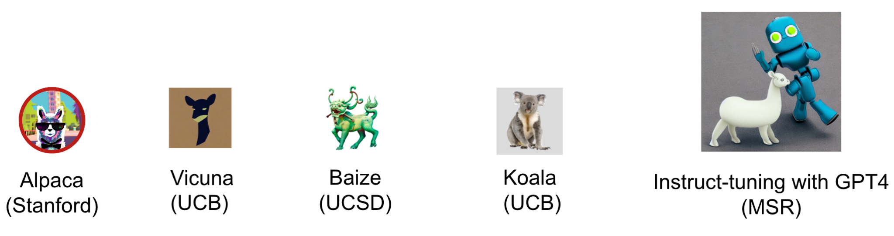
A Silver Lining: Lots of Open-Source Activity
Better base models (e.g., LLaMa)
Open-source replications of chatbots
We will benefit from the alliance with the open-source community.

Slide 116
Thanks!

